Slide 1
To Analyse Customer’s Perception Towards Telecommunication Industry In India
Project Guide: Dr. S.B. Muley
Project Members:
Manisha Gupta
Sadaf Sayyed
Arzoo Shaikh
Manoj Chaudhari
Lankesh Chavan
KISHINCHAND CHELLARAM COLLEGE, CHURCHGATE, MUMBAI 400020
DEPARTMENT OF STATISTICS

Slide 2
Steps involved in Conducting Survey
Why “Customer’s perception towards telecommunication industry”?
Telecommunication now-a-days is one of our basic needs. It helps us to connect with each and part of the world. As the years are passing it is growing even more stronger. In today’s digital ecosystem, telecom has become the foundation for business, governments, communities and families to effortlessly connect and share information. As the economic and social disruption caused by the pandemic, people across the globe rely on telecom sector.
Telecommunication is no longer limited to phone and fax only. Today, this company encompasses the high-speed internet, messaging, video streaming, online payments and many more services. Emerging technologies, such as 5G and cloud-hosted VoIP, are fueling it’s growth. From travelling and watching TV to doing business, telecom services are at the centre of everyday life.
Telecommunication companies are now using Artificial Intelligence(AI) and Machine Learning(ML) to improve customer service. With these technologies, companies can identify leads, analyse customer data and develop better products.
Preparatory Phase
Designing the Questionnaire
Pilot Survey
Modification of Questionnaire
Actual/Final Survey
Data Cleaning
Coding of the Data
Analysis of Data using Various Statistical Packages
Interpretation of Results
Conclusion
Reporting

Slide 3
Objectives
Description
Two types of research has been conducted mentioned as follows:
Primary Research:
It is a survey based research in which we have collected quantitative data via google forms. It is non-probabilistic convenience sampling method. In all 587 responses were recorded and considered for analysis. The open and close end questions were included in the questionnaire to study the objectives. Questionnaire was divided into two parts:
Respondent’s profile
Objective based questions
i. Customer care services
ii. Cost and Offers
iii. Problem faced by customers
iv. Service providers
Secondary Research:
For this analysis we’ve considered TRAI data from year 2011-19. Current working services like “Bharati Airtel”, “VI”, “Jio”, “MTNL” and “BSNL” were in major focus. We’ve forecasted and analysed the trend of these networks.
Primary Objectives-
To determine most preferred network
Expected benefits from the service provider
Quality of the current network
To study the reason for the growth of private sectors compared the public sector
Secondary Objective-
To study the growth of telecommunication industry in India

Slide 4
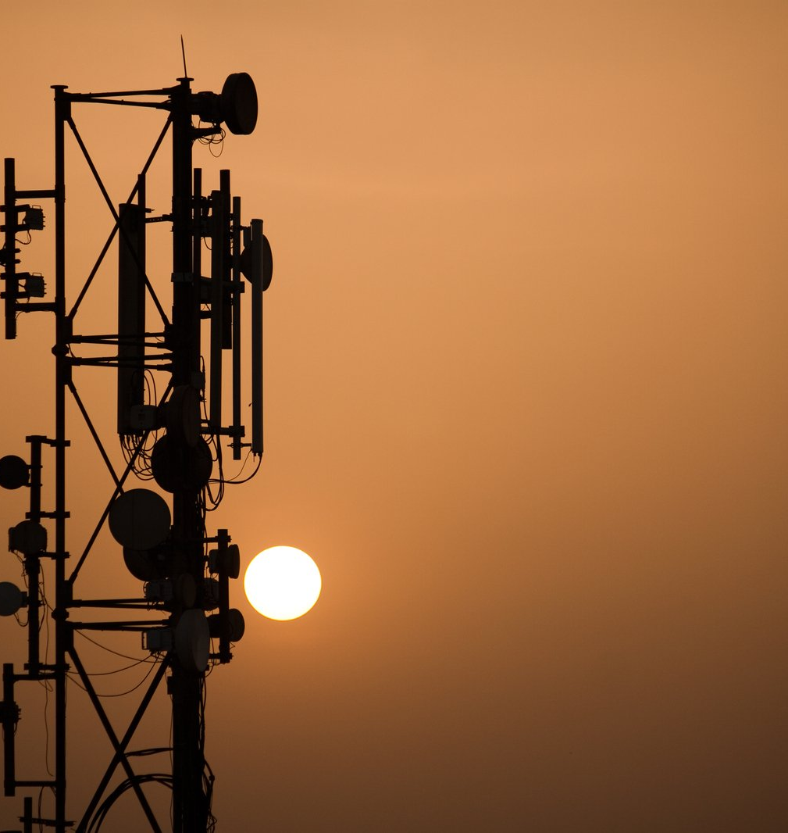
Primary Data Analysis
Primary Data Analysis was started with some basic graphical representation for visualizing our raw data collected and then analysed on R software using some “Statistical techniques” as well as “Machine Learning techniques”.
The techniques are mentioned as follows:
Multiple Logistic Regression (MLR)
Structural Equation Modelling (SEM)
Mann-Whitney U Test
Kruskal Wallis Test

Slide 5
Graphical Representation

Slide 6
Multiple Logistic Regression
Multiple Logistic Regression is a predictive modelling algorithm. It consists of one dichotomous dependent variable and independent variable of ordinal or interval scale. It helps us to give predictive model by calculating the probabilities of data.
The model for Logistic Regression is given by:
Model : Y = logb P = β0 + β1X1 + β2X2
1-P
null deviance = 265.35 with 384 df, residual deviance = 241.75 with 378 df, AIC = 255.75, FSI = 5.
Accuracy(train = 89.09%, test=88.96%)
The obtained predictive model is as follows:
Service type = - 2.9383 + (0.6879*clarity of video) – (0.4932*internet calling) – (0.4640*lag in audio/video) + (0.4910*lag message delivered) + ( 0.3230*politeness of staff) - ( 0.3926 *offer provided by service provider)
Multiple Logistic Regression was used to predict whether the customer will opt for “prepaid” or “post-paid” type of service based on the services received and problems faced
Assumptions:
Sample size >500.
Multicollinearity & Autocorrelation should not exist among & between independent variables.
Linear relationship between dependent and independent variable.
All the variables should be normally distributed.
Coefficients: | Pr(>|z|)
Intercept | 8.1e-06 ***
Clarity of video | 0.00861 **
Internet calling | 0.04738 *
Lag in audio/video | 0.07262 .
Late message delivered | 0.02713 *
Politeness of staff | 0.01752 *
Offer SV | 0.01054 *

Slide 7
Here, the Multiple Logistic Regression was used to predict whether the customer will opt for the “Government Sector” or “Private Sector” based on the services provided by them such as “Call Connection”, “Internet Browsing” and “Clarity of Video”
Since most of the responses were in the favour of private sector. The model has also predicted for private sector as it gave most of the probabilities greater than 0.5 i.ie for private sector.
null deviance = 276.4 with 414 df, residual deviance = 265.38 with 411 df, AIC = 255.75, FSI = 5.
Accuracy(train = 89.55%, test=87.35%)
The obtained predictive model is as follows:
Service sector = 1.1529 + (0.3282* call connection) + (0.4726* internet browsing) – (0.4786* clarity of video)
This model can be used to likely predict whether customer will opt for government and private sector.
Coefficients: | Pr(>|z|)
Intercept | 0.00978 **
Call Connection | 0.14032
Internet Browsing | 0.08669
Clarity of Video | 0.06182

Slide 8
The Measure Fit Index values of our fitted structural equation model are also obtained and all the values of measures are within the required ranges hence accepted.
Structural Equation Modelling (SEM)
Structural Equation Modelling is used to analyse the impact and relationship between laten construct and observed variables. It includes confirmatory factor analysis, confirmatory composite analysis, path analysis, partial least square modelling and latent growth modelling. It helps in estimating multiple and interrelated dependencies in a single analysis. There are two main components in the SEM distinguished as – The Structural Model that shows dependencies between endogenous variables and exogenous variables, and The Measurement Model shows relationship between latent variables and their indicators.
HYPOTHESIS:
H₀: there is no significant impact of satisfaction w.r.t (vm, ccs, prb, ser) on recommendation of the service provider to family and friends
H₁: there is significant impact of satisfaction w.r.t (vm, ccs, prb, ser) on recommendation of the service provider to family and friends
Goodness of fit Criteria | Fit Indices | Good Fit | Acceptable Fit | Goodness of Fit Values Obtained | Fit Situations
Statistic of ꭓ² Test | ꭓ² | 0.00 < ꭓ² < 2 | 2 < ꭓ² < 5 | 0.00 | Accepted
Root Mean Square Error of Approximation | RMSEA | 0.00 < RMSEA < 0.05 | 0.05 < RMSEA < 0.10 | 0.070 | Accepted
Standardized Root Mean Square Residual | SRMR | 0.00 < SRMR < 0.05 | 0.05 < SRMR <0.10 | 0.037 | Accepted
Comparative Fit Index | CFI | 0.97< CFI <=1 | 0.9 < CFI < 1 | 0.941 | Accepted
Tucker-Lewis Index | TLI | 0.95 < TLI < 1 | 0.9 < TLI < 1 | 0.931 | Accepted

Slide 9
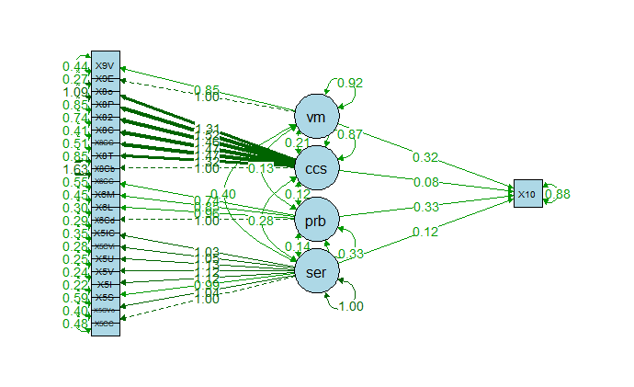
Variables | Regression Coefficients | P(>|z|)
Network recommendation on ~
Service Ratings (ser) | 0.119 | 0.011
Problems faced by Customers (prb) | 0.333 | 0.000
Customer Care Services (ccs) | 0.084 | 0.075
Cost and Offers (vm) | 0.323 | 0.000
The coefficient scores associated with “Service Ratings (ser)”, “Problem faced by customers (prb)”, “Customer Care Services (ccs)”, and “Cost and Offers (vm)” with respect to “Network recommendation” is 0.119, 0.333, 0.084 and 0.323 respectively. All the P-values are positive and significant with a P-value (<0.01) indicates that the person is satisfied with the services he/she is receiving by the network and he/she is likely to recommend their current using network to their family and friends.

Slide 10
Mann-Whitney U Test
the Mann Whitney U test is a nonparametric test of the null hypothesis that, for randomly selected values X and Y from two populations, the probability of X being greater than Y is equal to the probability of Y being greater than X.
By analysing the result it is seen that there is no such difference in clarity of video and internet browsing but though there is a significant difference between the call connectivity of government and private sectors.
As most of the responses received in the favour of government sector were from rural areas. As it is mostly observed that private networks are weaker as compared to government in the rural areas where as in urban and semi urban areas private networks are strong which might result in differing the call connectivity.
The first test was conducted to analyse the difference between services provided by government and private sector. that whether do these sectors provide different “call connection” , “internet browsing”, “clarity in video” service.
Hypothesis :
H_{0A}: There is no significant difference among the call connection/internet browsing/clarity in video service provided by government and private sector.
H_{1A}: There is significant difference among the call connection/internet browsing/clarity in video service provided by government and private sector.
Assumptions:
All the observations from both groups are independent of each other,
The responses are at least ordinal (i.e., one can at least say, of any two observations, which is the greater),
Under the null hypothesis H₀, the distributions of both populations are equal.
The alternative hypothesis H₁ is that the distributions are not equal.

Slide 11
The second test was conducted to analyse the difference between prepaid and post-paid services.
Hypothesis :
H_{0B}: There is no significant difference between the customer care services provided by prepaid and post-paid type of services.
H_{1B}: There is significant difference between the customer care services provided by prepaid and post-paid type of services.
Since all the p-values obtained are greater than 0.5. We rejected the null hypothesis that there is a significant difference between the customer care services provided by prepaid and post-paid types of services.
The conclusion drawn out of it is that, the people who are using prepaid services get cheaper and flexible plans comes with fewer perks and features, whereas post-paid users plans are more expensive, but they often get more discounts and other benefits, like more reliable data speed.
Prepaid customers doesn’t assure the guarantee to stay with their current using telecom network, whereas the post-paid customers are assumed to be more reliable to stay at least for one more year with their current using network.
The above mentioned reasons are the reasons why the customer care service are more polite to post-paid users as compared to prepaid users.

Slide 12
Kruskal-Wallis Test
The Kruskal-Wallis test is a nonparametric (distribution free) test, and is used when the assumptions of one-way ANOVA are not met.
In ANOVA, we assume that the dependent variable is normally distributed and there is approximately equal variance on the scores across groups. when using the Kruskal-Wallis Test, we do not have to make any of these assumptions. Therefore, the Kruskal-Wallis test can be used for both continuous and ordinal-level dependent variables.
Kruskal-Wallis chi-squared | 0.88855
Degrees of Freedom | 1
p-value | 0.3459
To first test was conducted to analyse the difference between average score of meeting expectation and the five different service providers.
Hypothesis :
H_{0D}: There is significant difference between the average score of meeting expectation and the five different service providers.
H_{1D}: There is no significant difference between the average score of meeting expectation and the five different service providers.
Assumptions:
We assume that the samples drawn from the population are random.
We also assume that the observations are independent of each other.
The measurement scale for the dependent variable should be at least ordinal.
Conclusion:
Since, p-value > alpha=0.05, we fail to reject the null hypothesis.
Hence, there is no difference between the average score of meeting expectation and the five different service providers.

Slide 13
To second test was conducted to analyse the difference between average score of value for money and the five different service providers.
Hypothesis :
H_{0E}: There is no significant difference between the average score of value for money and the five different service providers.
H_{1E}: There is significant difference between the average score of value for money and the five different service providers.
Conclusion:
Since, p-value > alpha=0.05, we fail to reject the null hypothesis.
Hence, there is no significant difference between the average score of value for money and the five different service providers.
Kruskal-Wallis chi-squared | 1.1939
Degrees of Freedom | 1
p-value | 0.2745

Slide 14
Secondary Data Analysis
A view of Data
We have considered TRAI data for this analysis for year range 2011-12 to 2019-20.
Current working service providers like ‘Bharti Airtel’, ‘Jio’, ‘Vodafone Idea (VI)’, ‘MTNL’ and ‘BSNL’ has been considered.

Slide 15
Time Series
Models to Forecast:
ARIMA
Exponential smoothing state space method (ets)
Naïve Model
Holt’s Linear Trend Method
Stationarity Check
Hypothesis:
H0: Data is not stationary.
H1: Data is stationary.
Conclusion: p-value > 0.05,
we reject null hypothesis and conclude data is stationary.
Holt’s Method
Assumption: It have level, trend but no seasonality.
ARIMA Model
Autoregressive integrated moving average.
Assumption: Data should be stationary and univariate.
Service Providers | P-value
VI | 0.99
Bharti Airtel | 0.66
Reliance Jio | 0.99
BSNL | 0.455
MTNL | 0.2993

Slide 16
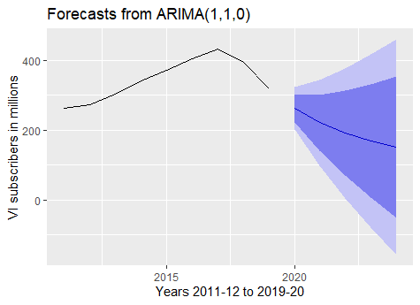
RESULT FOR ANALYSIS Vodafone Idea (VI)
Best Model: ARIMA(1, 1, 0) AR(1) = 0.7408
AIC | AICc | BIC
81.47 | 83.87 | 81.63
Forecast:
Years | Forecast
2020 | 263.1127
2021 | 221.5847
2022 | 190.8203
2023 | 168.0296
2024 | 151.1459
To check for residuals for fitted AR(1) model
H0_{(VI)}: Residuals are independent H1_{(Vi)}: Residuals are dependent
Q* = 3.6637, df = 3, p-value = 0.3001
Model df: 1. Total lags used: 4
Conclusion: Since p-value = 0.3001 > 0.05, we do not reject null hypothesis.
Accuracy: 94.56%
Actual count 2020= 286 million | ARIMA forecast = 263.1127 million
Conclusion: Forecast shows a decreasing graph.

Slide 17
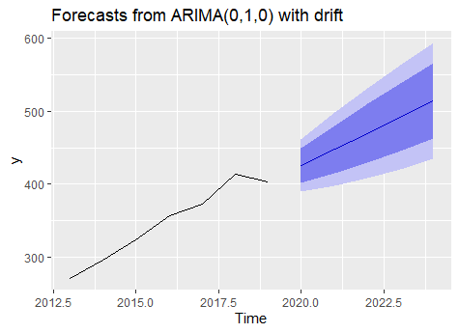
Bharti Airtel
Best Model: ARIMA(0, 1, 0) with drift drift = 22.0700
AIC | AICc | BIC
34.68 | 58.68 | 54.26
Forecast
To check for residuals for fitted ARIMA(0, 1, 0) with drift
H0_{(Airtel)}: Residuals are independent
H1_{(Airtel)}: Residuals are dependent
Q* = 3.3155, df = 3, p-value = 0.3455
Model df: 2. Total lags used: 5
Conclusion: Since p-value > 0.05, we do not reject null hypothesis.
Therefore, we conclude that residuals are independent which is to claim a good fit.
Year | Forecast
2020 | 425.72
2021 | 447.79
2022 | 469.86
2023 | 491.93
2024 | 514
Accuracy: 97.054312
Actual count = 425.72 million | ARIMA count = 423.29 million
Conclusion: Forecast shows an increasing graph.

Slide 18
Reliance Jio
Best Model: ARIMA(0, 1, 0)
AIC | AICc | BIC
37.83 | 41.83 | 36.93
ARIMA Forecast
Holt’s Forecast
Our model is a good fit.
To check for residuals for fitted ARIMA(0, 1, 0)
H0_{(Jio)}: Residuals are independent
H1_{(Jio)}: Residuals are dependent
p-value = 0.4377
Conclusion: Since p-value > 0.05, we do not reject null hypothesis.
Therefore, we conclude that residuals are independent which is to claim a good fit.
Year | Forecast
2020 | 387.52
2021 | 387.52
2022 | 387.52
2023 | 387.52
2024 | 387.52
Year | Forecast
2020 | 465.40
2021 | 543.28
2022 | 621.16
2023 | 699.04
2024 | 776.92

Slide 19
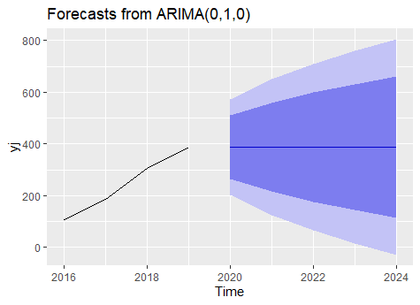
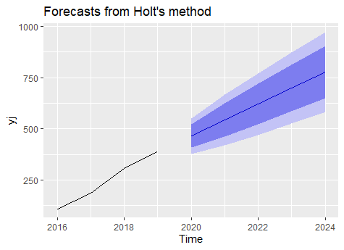
Forecast graph and conclusion
Comparison between forecasts
Actual = 387.52 million
ARIMA = 410.8 million
Holt’s = 465.40 million
Conclusion: Both the forecast shows a constant and increasing graph respectively.
It can be seen that Reliance Jio has a scope of hike in the future.

Slide 20
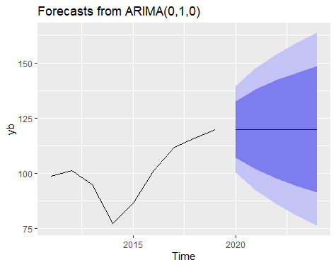
BSNL
Best Model: ARIMA(0, 1, 0)
AIC | AICc | BIC
61.54 | 62.21 | 61.62
Forecast
To check for residuals for fitted ARIMA(0, 1, 0) with drift
H0_{(BSNL)}: Residuals are independent
H1_{(BSNL)}: Residuals are dependent
p-value = 0.335
Conclusion: Since p-value = 0.335 > 0.05, we do not reject null hypothesis. Therefore, it can be concluded that the fitted ARIMA model is independent of residuals and is good fit for further forecasting.
Year | Forecast
2020 | 119.87
2021 | 119.87
2022 | 119.87
2023 | 119.87
2024 | 119.87
Accuracy: 91.7927
Conclusion: The forecast shows a constant graph.
It can be seen that BSNL has a constant scope.

Slide 21
MTNL
Best Model: ARIMA(0, 1, 0)
AIC | AICc | BIC
17.85 | 18.52 | 17.93
ARIMA Forecast
Holt’s Forecast
Our model is a good fit.
To check for residuals for fitted ARIMA(0, 1, 0)
H0_{(MTNL)}: Residuals are independent
H1_{(MTNL)}: Residuals are dependent
p-value = 0.6606
Conclusion: Since p-value > 0.05, we do not reject null hypothesis.
Therefore, we conclude that residuals are independent which is to claim a good fit.
Year | Forecast
2020 | 3.36
2021 | 3.36
2022 | 3.36
2023 | 3.36
2024 | 3.36
Year | Forecast
2020 | 2.676188
2021 | 2.426420
2022 | 2.176653
2023 | 1.926885
2024 | 1.677118

Slide 22
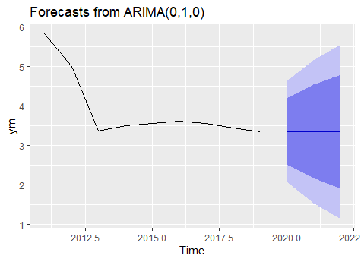
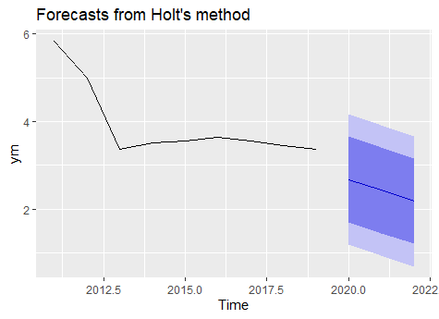
Forecast graph and conclusion
Comparison between forecasts
Actual = 3.36 million
ARIMA = 2.67 million
Holt’s = 2.17 million
Conclusion: Both the forecast shows a constant and decreasing graph respectively.
It can be seen that MTNL may have a constant subscribers rate or may face a fall down.

Slide 23
Conclusion & Suggestion
From the survey we concluded that Jio is the most preferred network because they are coming up with better services with cheaper prices and more perks.
VI failed to give better services as compared to Idea and Vodafone individually.
Private sector is more preferred over government sector because of it’s constant upgrades and new features with cheap cost which makes it more preferable for the user especially people of the age group 18-25.
The government sectors fail to bring new ideas and upgrades for the users due to which people switch from government to private
Although Jio is the most preferred network and recently it is about to launch it’s 5G internet service, it still lag to provide best 4G service. So, a simple suggestion would be to focus on current network rather than upgradation.
Service providers like Idea and Vodafone should have worked separately instead of merging and coming up with VI, as they were having better performance individually.
Even though, private sector is more preferred over government sector, it is only restricted to regions like Urban and Semi-urban. When it comes to rural region it doesn’t fulfil service criteria and vice-versa is true for government too. So both the sectors should focus on their weaker section.

Slide 24
Thank You!

